Slide 1

Efood | BI Analyst Case Study
Vasileios Anastasopoulos
May 8st, 2021

Slide 2
Agenda
KPIs Analysis
Coffee Segment Analysis
Appendix

Slide 3
KPIs Analysis

Slide 4
We will focus on the following KPIs in order to monitor our customers’ behavior, as well as the business performance:
Order Amount: the total amount of orders per cuisine and city of interest
Average Basket Size: the average size of basket per cuisine and city of interest
Unique Shops Available: the number of unique available shops per cuisine and city
Daily Average Orders: the daily average orders per cuisine and city
Customers Monthly Average Orders: the average number of orders submitted by a client on a monthly basis
Customers Monthly Average Basket: the average basket size of a client on a monthly basis
Customer Segment (by order amount): breakdown of clients depending on the orders they submit
Customer Segment (by total basket size): breakdown of clients depending on their basket size
Note: The Data Studio report and respective dashboards created for the analysis can be found here: https://datastudio.google.com/reporting/a5d97369-75fc-4098-a19b-f5a6d845c0eb/page/z8wHC

Slide 5
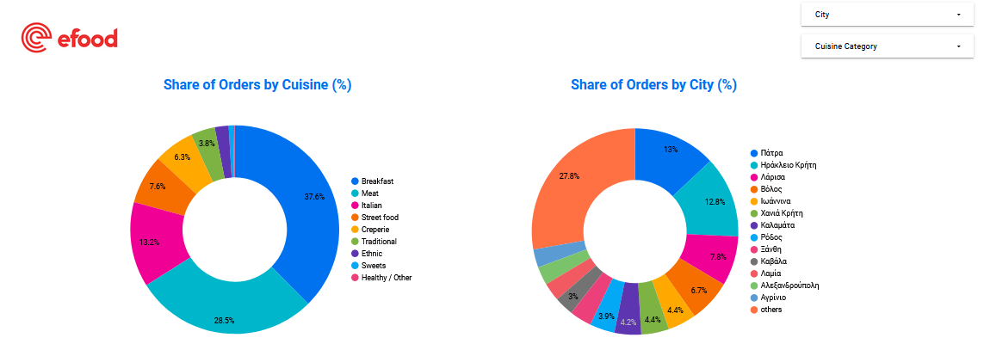
Almost 70% of total orders across all cities refer to Breakfast and Meat
Patra and Irakleio are the leading cities, based on their received order volume
Note: The Data Studio report and respective dashboards created for the analysis can be found here: https://datastudio.google.com/reporting/a5d97369-75fc-4098-a19b-f5a6d845c0eb/page/z8wHC
Data refers to January 2021

Slide 6
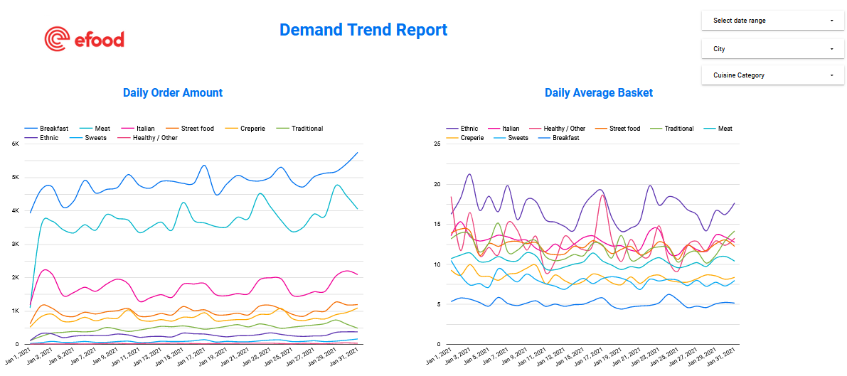
Breakfast receives the majority of orders across cities, followed by Meat
Yet, breakfast category faces the lowest basket size among cuisines
Use the filters for additional segmentation
Note: The Data Studio report and respective dashboards created for the analysis can be found here: https://datastudio.google.com/reporting/a5d97369-75fc-4098-a19b-f5a6d845c0eb/page/z8wHC
Data refers to January 2021

Slide 7
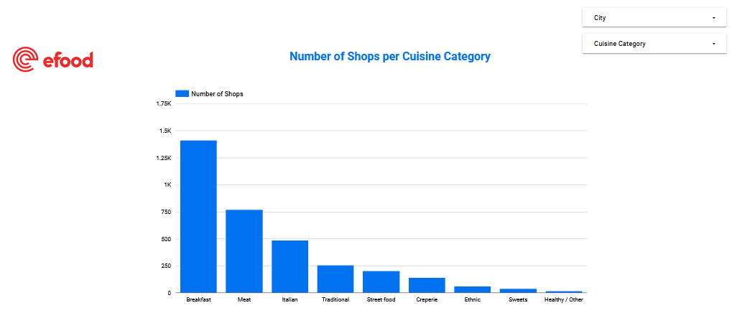
The majority of available shops offer “Breakfast”, followed by those delivering “Meat” and “Italian” food
Combining this information with the previous slide, we can identify where there is high demand but not adequate shops and vice versa
Use the filters for additional segmentation
Note: The Data Studio report and respective dashboards created for the analysis can be found here: https://datastudio.google.com/reporting/a5d97369-75fc-4098-a19b-f5a6d845c0eb/page/z8wHC
Data refers to January 2021

Slide 8
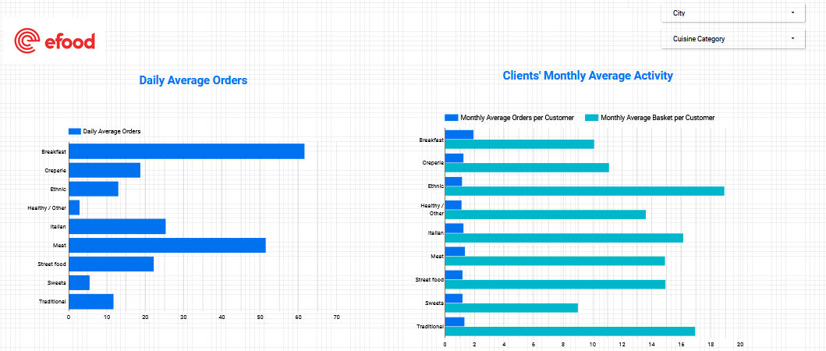
Breakfast, Meat and Italian cuisines receive the most traffic on a daily basis
Customers submit every month 1.94 breakfast-related orders on average
Use the filters for additional segmentation
Note: The Data Studio report and respective dashboards created for the analysis can be found here: https://datastudio.google.com/reporting/a5d97369-75fc-4098-a19b-f5a6d845c0eb/page/z8wHC
Data refers to January 2021

Slide 9
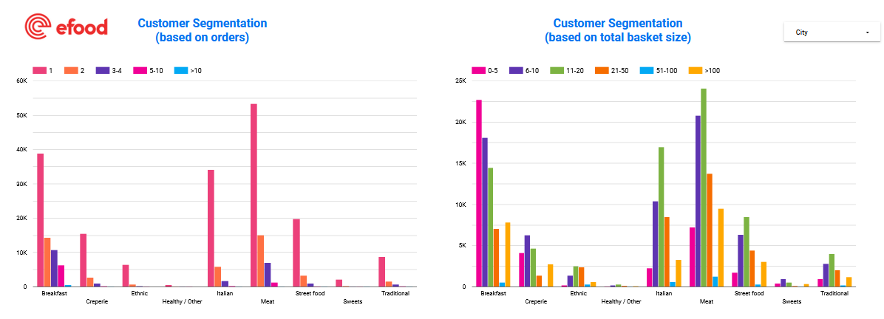
Across cuisines, the majority of customers order one or two times on a monthly basis
A significant number of clients order Breakfast between 3 and 10 times per month)
Order Group Segment
Basket Group Segment
Number of Customers
Number of Customers
Note: The Data Studio report and respective dashboards created for the analysis can be found here: https://datastudio.google.com/reporting/a5d97369-75fc-4098-a19b-f5a6d845c0eb/page/z8wHC
Data refers to January 2021

Slide 10
The size of the respective “Basket” customer segment depends on the actual basket size of each cuisine (i.e. Breakfast that has an overall low average basket, has the most clients in the “0-5” basket segment)
Order Group Segment
Basket Group Segment
Number of Customers
Number of Customers
Note: The Data Studio report and respective dashboards created for the analysis can be found here: https://datastudio.google.com/reporting/a5d97369-75fc-4098-a19b-f5a6d845c0eb/page/z8wHC
Data refers to January 2021

Slide 11
Coffee Segment Analysis

Slide 12
Which Cuisines should we target to increase our Coffee-related orders?
In order to identify potential segments interested in coffee, we need to focus on the particular hours during the day with the highest demand across the available cuisines
Breakfast: it could be the main category to target
Creperie: people interested in this food category might want to enjoy also a coffee
Sweets: customers looking for a sweet could be an additional potential segment
Healthy: a person interested in a healthy smoothie might be also interested in coffee as an extra source of energy (eg. decaffeinated coffee)

Slide 13
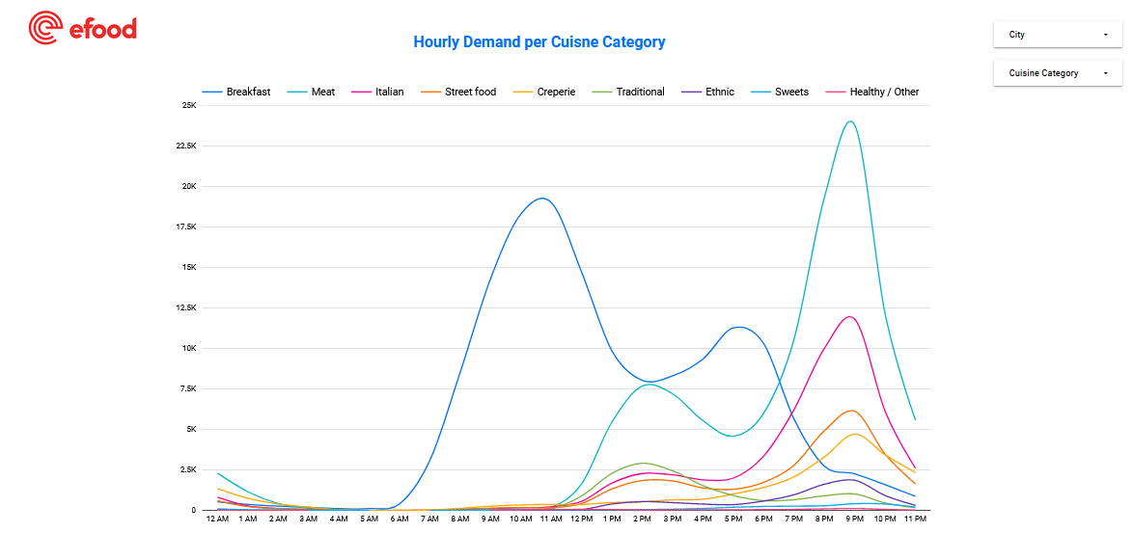
Using the below dashboard, we can trace the heavy hours for the particular cuisines and cities
Number of Orders
Note: The Data Studio report and respective dashboards created for the analysis can be found here: https://datastudio.google.com/reporting/a5d97369-75fc-4098-a19b-f5a6d845c0eb/page/z8wHC
Data refers to January 2021

Slide 14
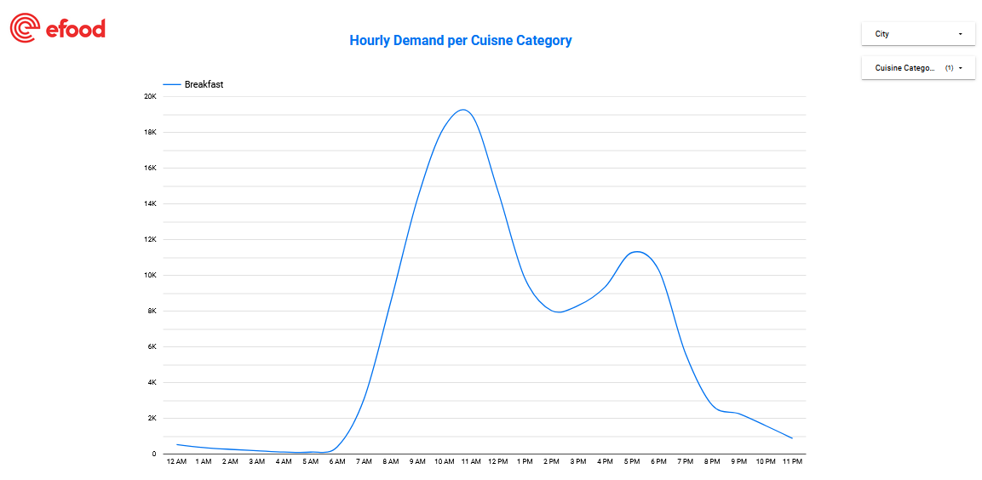
Breakfast: Morning hours (09:00am-11:00am) enjoy the majority of orders, while demand is growing again early in the evening (5:00pm)
Respectively, we can choose the rest cuisines to identify peak points
Use the filters for additional segmentation
Number of Orders
Note: The Data Studio report and respective dashboards created for the analysis can be found here: https://datastudio.google.com/reporting/a5d97369-75fc-4098-a19b-f5a6d845c0eb/page/z8wHC
Data refers to January 2021

Slide 15
Thank you!

Slide 16
Appendix

Slide 17
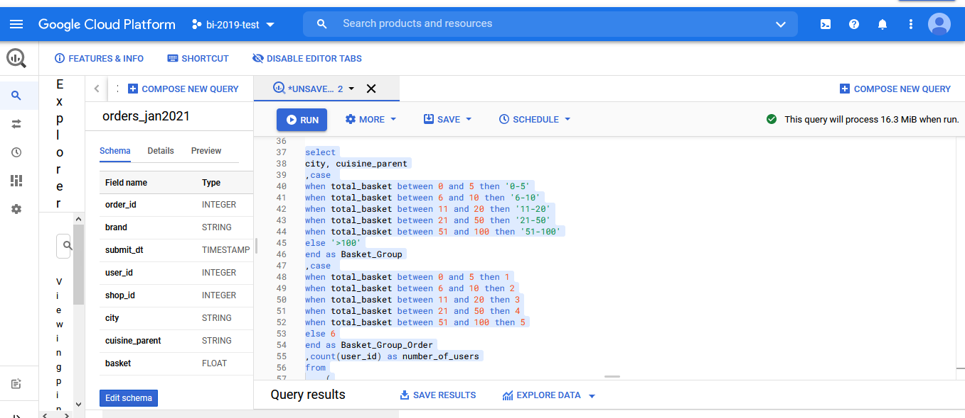
Indicative Queries screenshots

Slide 18
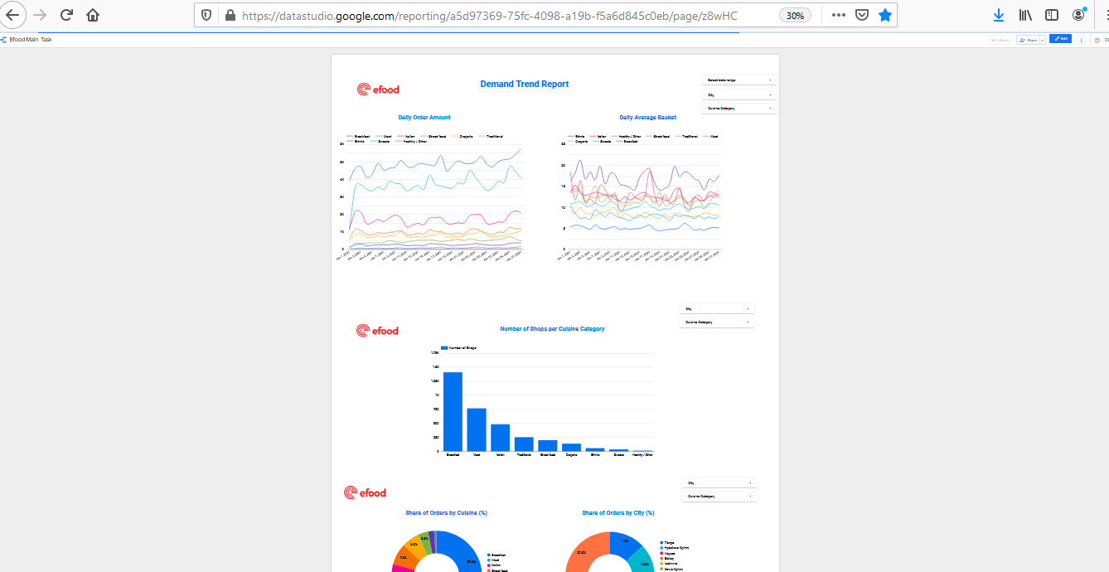
Indicative Dashboards screenshots

